Slide 1
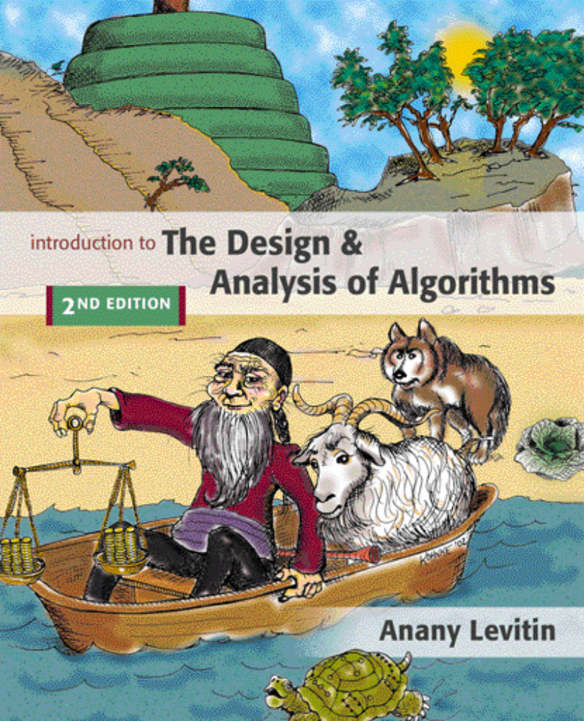

Chapter 1
Introduction
Copyright © 2007 Pearson Addison-Wesley. All rights reserved.

Slide 2
What is an algorithm?
An algorithm is a sequence of unambiguous instructions for solving a problem, i.e., for obtaining a required output for any legitimate input in a finite amount of time.
problem
algorithm
“computer”
input
output
1-<number>

Slide 3
Algorithm
An algorithm is a sequence of unambiguous instructions for solving a problem, i.e., for obtaining a required output for any legitimate input in a finite amount of time.
Can be represented various forms
Unambiguity/clearness
Effectiveness
Finiteness/termination
Correctness
1-<number>

Slide 4
Historical Perspective
Euclid’s algorithm for finding the greatest common divisor
Muhammad ibn Musa al-Khwarizmi – 9th century mathematician www.lib.virginia.edu/science/parshall/khwariz.html
1-<number>
Notes:
Euclid’s algorithm is good for introducing the notion of an algorithm because it
makes a clear separation from a program that implements the algorithm.
It is also one that is familiar to most students.
Al Khowarizmi (many spellings possible...) – “algorism” (originally) and then
later “algorithm” come from his name.

Slide 5
Notion of algorithm and problem
problem
algorithm
“computer”
input
(or instance)
output
algorithmic solution
(different from a conventional solution)
1-<number>

Slide 6
Example of computational problem: sorting
Statement of problem:
  Input: A sequence of n numbers <a₁, a₂, …, a_{n}>
  Output: A reordering of the input sequence <a´₁, a´₂, …, a´_{n}> so that a´_{i} ≤ a´_{j} whenever i < j
Instance: The sequence <5, 3, 2, 8, 3>
Algorithms:
  Selection sort
  Insertion sort
  Merge sort
  (many others)
1-<number>

Slide 7
Selection Sort
Input: array a[1],…,a[n]
Output: array a sorted in non-decreasing order
Algorithm:
for i=1 to n
swap a[i] with smallest of a[i],…,a[n]
Is this unambiguous? Effective?
See also pseudocode, section 3.1
1-<number>
Notes:
The algorithm is given *very* informally here. Show students the pseudocode in
section 3.1.
This is a good opportunity to discuss pseudocode conventions.

Slide 8
Some Well-known Computational Problems
Sorting
Searching
Shortest paths in a graph
Minimum spanning tree
Primality testing
Traveling salesman problem
Knapsack problem
Chess
Towers of Hanoi
Program termination
Some of these problems don’t have efficient algorithms, or algorithms at all!
1-<number>
Notes:
1-4 have well known efficient (polynomial-time) solutions
5: primality testing has recently been found to have an efficient solution
This is a great problem to discuss because it has recently been in the news
(see mathworld news at: http://mathworld.wolfram.com/news/2002-08-07_primetest/
or original article: http://www.cse.iitk.ac.in/primality.pdf)
6(TSP)-9(chess) are all problems for which no efficient solution has been found
it is possible to informally discuss the “try all possibilities” approach that is required
to get exact solutions to such problems
10: Towers of Hanoi is a problem that has only exponential-time solutions (simply
because the output required is so large)
11: Program termination is undecidable

Slide 9
Basic Issues Related to Algorithms
How to design algorithms
How to express algorithms
Proving correctness
Efficiency (or complexity) analysis
  Theoretical analysis
  Empirical analysis
Optimality
1-<number>

Slide 10
Algorithm design strategies
Brute force
Divide and conquer
Decrease and conquer
Transform and conquer
Greedy approach
Dynamic programming
Backtracking and branch-and-bound
Space and time tradeoffs
1-<number>

Slide 11
Analysis of Algorithms
How good is the algorithm?
  Correctness
  Time efficiency
  Space efficiency
Does there exist a better algorithm?
  Lower bounds
  Optimality
1-<number>

Slide 12
What is an algorithm?
Recipe, process, method, technique, procedure, routine,… with the following requirements:
Finiteness
    terminates after a finite number of steps
Definiteness
    rigorously and unambiguously specified
Clearly specified input
    valid inputs are clearly specified
Clearly specified/expected output
    can be proved to produce the correct output given a valid input
Effectiveness
    steps are sufficiently simple and basic
1-<number>
Notes:
The formalization of the notion of an algorithm led to great breakthroughs in the
foundations of mathematics in the 1930s.

Slide 13
Why study algorithms?
Theoretical importance
  the core of computer science
Practical importance
  A practitioner’s toolkit of known algorithms
  Framework for designing and analyzing algorithms for new problems
Example: Google’s PageRank Technology
1-<number>

Slide 14
Euclid’s Algorithm
Problem: Find gcd(m,n), the greatest common divisor of two nonnegative, not both zero integers m and n
Examples: gcd(60,24) = 12, gcd(60,0) = 60, gcd(0,0) = ?
Euclid’s algorithm is based on repeated application of equality
gcd(m,n) = gcd(n, m mod n)
until the second number becomes 0, which makes the problem
trivial.
Example: gcd(60,24) = gcd(24,12) = gcd(12,0) = 12
1-<number>
Notes:
Euclid’s algorithm is good for introducing the notion of an algorithm because it
makes a clear separation from a program that implements the algorithm.
It is also one that is familiar to most students.
Al Khowarizmi (many spellings possible...) – “algorism” (originally) and then
later “algorithm” come from his name.

Slide 15
Two descriptions of Euclid’s algorithm
Step 1 If n = 0, return m and stop; otherwise go to Step 2
Step 2 Divide m by n and assign the value of the remainder to r
Step 3 Assign the value of n to m and the value of r to n. Go to
Step 1.
while n ≠ 0 do
r ← m mod n
m← n
n ← r
return m
1-<number>

Slide 16
Other methods for computing gcd(m,n)
Consecutive integer checking algorithm
Step 1 Assign the value of min{m,n} to t
Step 2 Divide m by t. If the remainder is 0, go to Step 3;
otherwise, go to Step 4
Step 3 Divide n by t. If the remainder is 0, return t and stop;
otherwise, go to Step 4
Step 4 Decrease t by 1 and go to Step 2
Is this slower than Euclid’s algorithm? How much slower?
O(n), if n <= m , vs O(log n)
1-<number>

Slide 17
Other methods for gcd(m,n) [cont.]
Middle-school procedure
Step 1 Find the prime factorization of m
Step 2 Find the prime factorization of n
Step 3 Find all the common prime factors
Step 4 Compute the product of all the common prime factors
and return it as gcd(m,n)
Is this an algorithm?
How efficient is it?
Time complexity: O(sqrt(n))
1-<number>

Slide 18
Sieve of Eratosthenes
Input: Integer n ≥ 2
Output: List of primes less than or equal to n
for p ← 2 to n do A[p] ← p
for p ← 2 to n do
if A[p] ≠ 0 //p hasn’t been previously eliminated from the list
j ← p* p
while j ≤ n do
A[j] ← 0 //mark element as eliminated
j ← j + p
Example: 2 3 4 5 6 7 8 9 10 11 12 13 14 15 16 17 18 19 20
Time complexity: O(n)
1-<number>

Slide 19
Two main issues related to algorithms
How to design algorithms
How to analyze algorithm efficiency
1-<number>

Slide 20
Algorithm design techniques/strategies
Brute force
Divide and conquer
Decrease and conquer
Transform and conquer
Space and time tradeoffs
Greedy approach
Dynamic programming
Iterative improvement
Backtracking
Branch and bound
1-<number>

Slide 21
Analysis of algorithms
How good is the algorithm?
  time efficiency
  space efficiency
  correctness ignored in this course
Does there exist a better algorithm?
  lower bounds
  optimality
1-<number>

Slide 22
Important problem types
sorting
searching
string processing
graph problems
combinatorial problems
geometric problems
numerical problems
1-<number>

Slide 23
Sorting (I)
Rearrange the items of a given list in ascending order.
  Input: A sequence of n numbers <a₁, a₂, …, a_{n}>
  Output: A reordering <a´₁, a´₂, …, a´_{n}> of the input sequence such that a´₁≤ a´₂ ≤ … ≤ a´_{n.}
Why sorting?
  Help searching
  Algorithms often use sorting as a key subroutine.
Sorting key
  A specially chosen piece of information used to guide sorting. E.g., sort student records by names.
1-<number>

Slide 24
Sorting (II)
Examples of sorting algorithms
  Selection sort
  Bubble sort
  Insertion sort
  Merge sort
  Heap sort …
Evaluate sorting algorithm complexity: the number of key comparisons.
Two properties
  Stability: A sorting algorithm is called stable if it preserves the relative order of any two equal elements in its input.
  In place : A sorting algorithm is in place if it does not require extra memory, except, possibly for a few memory units.
1-<number>

Slide 25
Selection Sort
Algorithm SelectionSort(A[0..n-1])
//The algorithm sorts a given array by selection sort
//Input: An array A[0..n-1] of orderable elements
//Output: Array A[0..n-1] sorted in ascending order
for i ← 0 to n – 2 do
min ← i
for j ← i + 1 to n – 1 do
if A[j] < A[min]
min ← j
swap A[i] and A[min]
1-<number>

Slide 26
Searching
Find a given value, called a search key, in a given set.
Examples of searching algorithms
  Sequential search
  Binary search …
Input: sorted array a_i < … < a_j and key x;
m ←(i+j)/2;
while i < j and x != a_m do
if x < a_m then j ← m-1
else i ← m+1;
if x = a_m then output a_m;
Time: O(log n)
1-<number>

Slide 27
String Processing
A string is a sequence of characters from an alphabet.
Text strings: letters, numbers, and special characters.
String matching: searching for a given word/pattern in a text.
Examples:
searching for a word or phrase on WWW or in a Word document
searching for a short read in the reference genomic sequence
1-<number>

Slide 28
Graph Problems
Informal definition
  A graph is a collection of points called vertices, some of which are connected by line segments called edges.
Modeling real-life problems
  Modeling WWW
  Communication networks
  Project scheduling …
Examples of graph algorithms
  Graph traversal algorithms
  Shortest-path algorithms
  Topological sorting
1-<number>

Slide 29
Fundamental data structures
list
  array
  linked list
  string
stack
queue
priority queue/heap
graph
tree and binary tree
set and dictionary
1-<number>

Slide 30
Linear Data Structures
Arrays
  fixed length (need preliminary reservation of memory)
  contiguous memory locations
  direct access
  Insert/delete
Linked Lists
  dynamic length
  arbitrary memory locations
  access by following links
  Insert/delete
Arrays
  A sequence of n items of the same data type that are stored contiguously in computer memory and made accessible by specifying a value of the array’s index.
Linked List
  A sequence of zero or more nodes each containing two kinds of information: some data and one or more links called pointers to other nodes of the linked list.
  Singly linked list (next pointer)
  Doubly linked list (next + previous pointers)
…
.
a1
a2
an
1-<number>

Slide 31
Stacks and Queues
Stacks
  A stack of plates
    insertion/deletion can be done only at the top.
    LIFO
  Two operations (push and pop)
Queues
  A queue of customers waiting for services
    Insertion/enqueue from the rear and deletion/dequeue from the front.
    FIFO
  Two operations (enqueue and dequeue)
1-<number>

Slide 32
Priority Queue and Heap
Priority queues (implemented using heaps)
  A data structure for maintaining a set of elements, each associated with a key/priority, with the following operations
    Finding the element with the highest priority
    Deleting the element with the highest priority
    Inserting a new element
  Scheduling jobs on a shared computer
9
6
8
5
2
3
9
6
8
5
2
3
1-<number>

Slide 33
Graphs
Formal definition
  A graph G = <V, E> is defined by a pair of two sets: a finite set V of items called vertices and a set E of vertex pairs called edges.
Undirected and directed graphs (digraphs).
What’s the maximum number of edges in an undirected graph with |V| vertices?
Complete, dense, and sparse graphs
  A graph with every pair of its vertices connected by an edge is called complete, K_{|V|}
1
2
3
4
1-<number>

Slide 34
Graph Representation
Adjacency matrix
  n x n boolean matrix if |V| is n.
  The element on the ith row and jth column is 1 if there’s an edge from ith vertex to the jth vertex; otherwise 0.
  The adjacency matrix of an undirected graph is symmetric.
Adjacency linked lists
  A collection of linked lists, one for each vertex, that contain all the vertices adjacent to the list’s vertex.
Which data structure would you use if the graph is a 100-node star shape?
0 1 1 1
0 0 0 1
0 0 0 1
0 0 0 0
2
3
4
4
4
1-<number>

Slide 35
Weighted Graphs
Weighted graphs
  Graphs or digraphs with numbers assigned to the edges.
5
1
2
6
9
7
3
8
4
1-<number>

Slide 36
Graph Properties -- Paths and Connectivity
Paths
  A path from vertex u to v of a graph G is defined as a sequence of adjacent (connected by an edge) vertices that starts with u and ends with v.
  Simple paths: All edges of a path are distinct.
  Path lengths: the number of edges, or the number of vertices – 1.
Connected graphs
  A graph is said to be connected if for every pair of its vertices u and v there is a path from u to v.
Connected component
  The maximum connected subgraph of a given graph.
1-<number>
Notes:
Examples of a simple path and a not simple path.
Connected graphs: starting from any vertex, we can always find a path to reach all the other vertices. (Ball-String example.)
From NIST:
Connected graphs:
Definition: An undirected graph that has a path between every pair of vertices.
Strongly connected graphs:
Definition: A directed graph that has a path from each vertex to every other vertex.
Connected component: …
Strongly connected component:
a strongly connected component of a digraph G is a maximal strongly connected subgraph of G.

Slide 37
Graph Properties -- Acyclicity
Cycle
  A simple path of a positive length that starts and ends a the same vertex.
Acyclic graph
  A graph without cycles
  DAG (Directed Acyclic Graph)
1
2
3
4
1-<number>

Slide 38
Trees
Trees
  A tree (or free tree) is a connected acyclic graph.
  Forest: a graph that has no cycles but is not necessarily connected.
Properties of trees
  For every two vertices in a tree there always exists exactly one simple path from one of these vertices to the other. Why?
    Rooted trees: The above property makes it possible to select an arbitrary vertex in a free tree and consider it as the root of the so called rooted tree.
    Levels in a rooted tree.
rooted
3
  |E| = |V| - 1
1
3
5
4
1
5
2
4
2
1-<number>

Slide 39
Rooted Trees (I)
Ancestors
  For any vertex v in a tree T, all the vertices on the simple path from the root to that vertex are called ancestors.
Descendants
  All the vertices for which a vertex v is an ancestor are said to be descendants of v.
Parent, child and siblings
  If (u, v) is the last edge of the simple path from the root to vertex v, u is said to be the parent of v and v is called a child of u.
  Vertices that have the same parent are called siblings.
Leaves
  A vertex without children is called a leaf.
Subtree
  A vertex v with all its descendants is called the subtree of T rooted at v.
1-<number>

Slide 40
Rooted Trees (II)
Depth of a vertex
  The length of the simple path from the root to the vertex.
Height of a tree
  The length of the longest simple path from the root to a leaf.
h = 2
3
4
1
5
2
1-<number>

Slide 41
Ordered Trees
Ordered trees
  An ordered tree is a rooted tree in which all the children of each vertex are ordered.
Binary trees
  A binary tree is an ordered tree in which every vertex has no more than two children and each children is designated s either a left child or a right child of its parent.
Binary search trees
  Each vertex is assigned a number.
  A number assigned to each parental vertex is larger than all the numbers in its left subtree and smaller than all the numbers in its right subtree.
⎣log₂n⎦ ≤ h ≤ n – 1, where h is the height of a binary tree and n the size.
9
6
6
8
3
9
5
2
3
2
5
8
1-<number>

